Slide 1
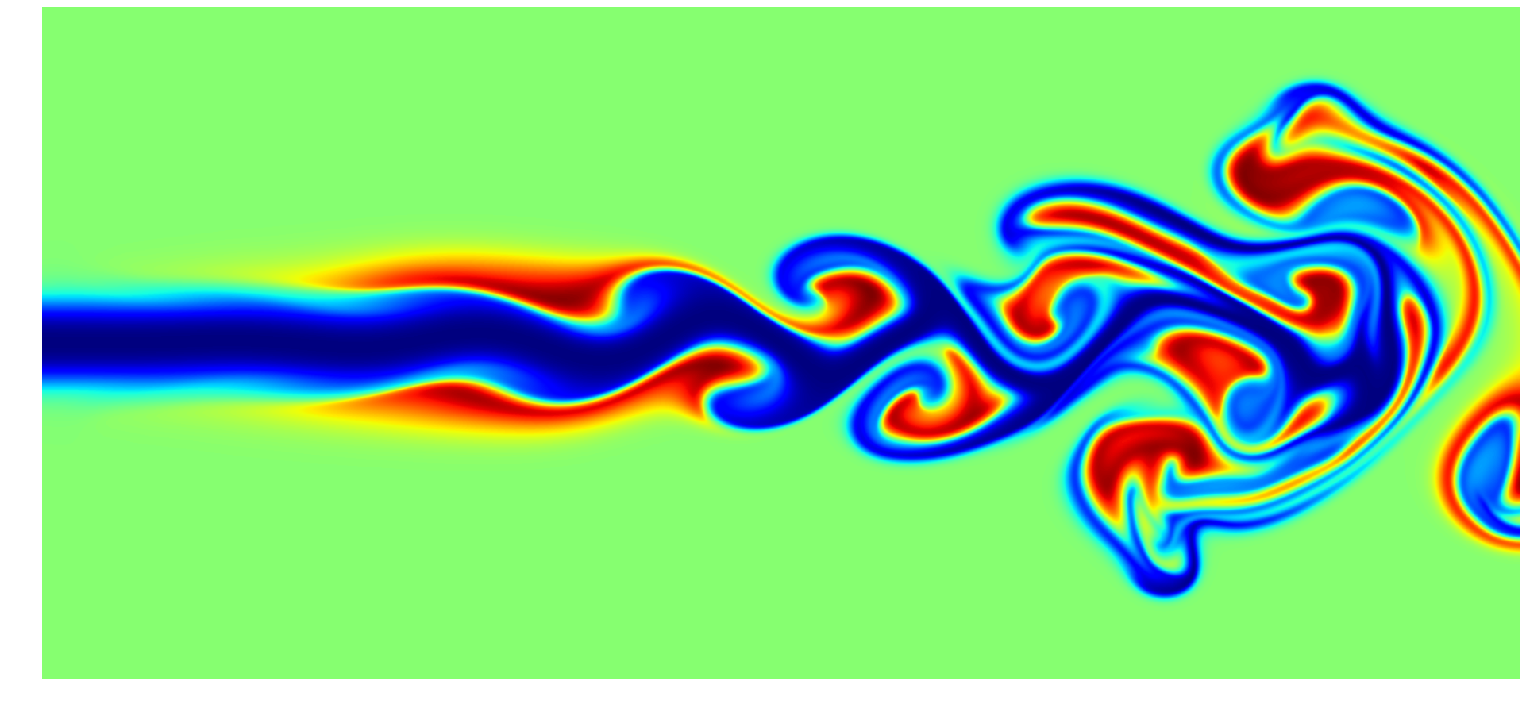
Parameter Learning for Differential Equations using Physics Informed Neural Networks
Tirthankar De
Enrollment: 233242023
BS-MS Physics
Course: PHC-351

Slide 2
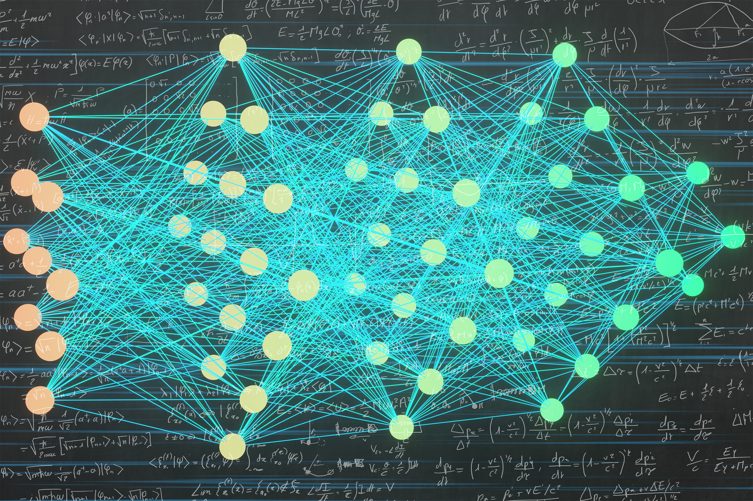
Deep Learning for Differential Equations
Deep neural networks are increasingly being used to tackle classical applied mathematics problems such as partial differential equations (PDEs) utilizing machine learning and artificial intelligence approaches.
Due to, for example, significant nonlinearities, convection dominance, or shocks, some PDEs are notoriously difficult to solve using standard numerical approaches.
Deep learning has recently emerged as a new paradigm of scientific computing thanks to neural networks’ universal approximation and great expressivity.
Recent studies have shown deep learning to be a promising method for building metamodels for fast predictions of dynamic systems.
In particular, Neural Networks have proven to represent the underlying nonlinear input-output relationship in complex systems.

Slide 3
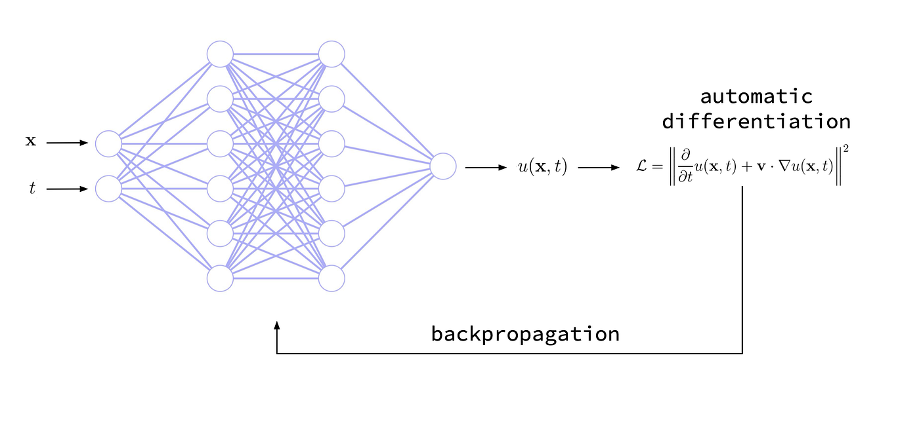
Physics Informed Neural Networks
Physics-Informed Neural Networks (PINNs) are a scientific machine learning technique used to solve problems involving PDEs.
PINNs approximate PDE solutions by training a neural network to minimize a loss function; it includes terms reflecting the initial and boundary conditions along the space-time domain’s boundary and the PDE residual at selected points in the domain (called collocation point).
PINNs are deep learning networks that, given an input point in the integration domain, produce an estimated solution in that point of a differential equation after training.
Incorporating a residual network that encodes the governing physics equations is a significant novelty with PINNs.

Slide 4
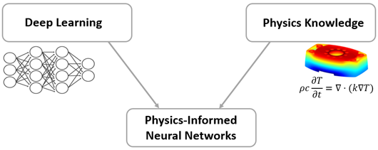
Why PINNs?
PINNs consider the underlying PDE, i.e., the physics of the problem, rather than attempting to deduce the solution based solely on data, i.e., by fitting a neural network to a set of state-value pairs.
PINNs are mesh-free methods that enable on-demand solution computation after a training stage, and they allow solutions to be made differentiable using analytical gradients.
They provide an easy way to solve forward jointly and inverse problems using the same optimization problem. In fact, the same code used to solve forward problems can be used to solve inverse problems with minimal modification.
PINNs can address PDEs in domains with very complicated geometries or in very high dimensions that are all difficult to numerically simulate as well as inverse and constrained optimization problems.

Slide 5
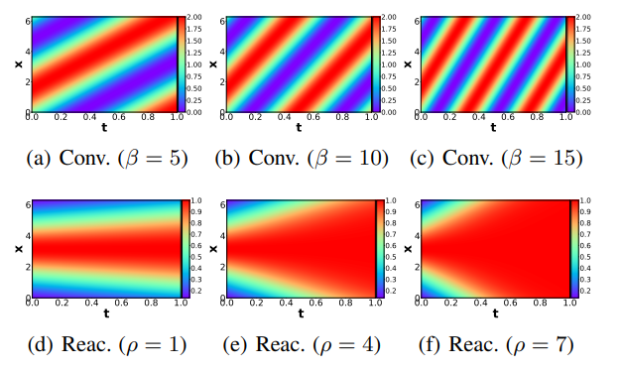
Need for parameter learning
Complex physical systems are often described by PDEs that depend on parameters such as the Reynolds number in fluid mechanics.
In applications such as design optimization or uncertainty quantification, solutions of those PDEs need to be evaluated at numerous points in the parameter space.
While physics-informed neural networks (PINNs) have emerged as a new strong competitor as a surrogate, their usage in this scenario remains underexplored due to the inherent need for repetitive and time-consuming training.
Fig: The ground-truth solutions of various convection equations with an initial condition of 1 + sin(x) and reaction equations with an initial condition of a Gaussian distribution N(π,(π/2)²). Varied solutions are made depending on changes in coefficient.

Slide 6
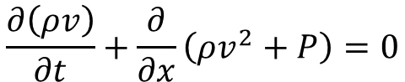
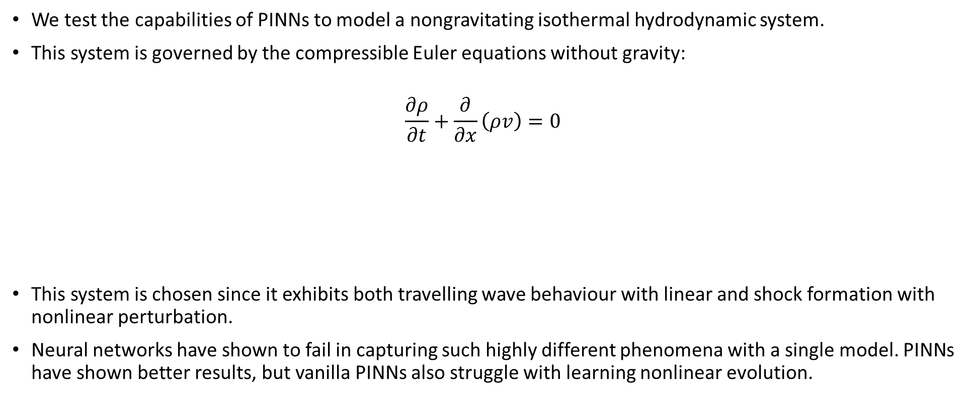
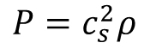
The system
We test the capabilities of PINNs to model a nongravitating isothermal hydrodynamic system.
This system is governed by the compressible Euler equations without gravity:
$$\frac{∂ρ}{∂t}+\frac{∂}{∂x}\left(ρv\right)=0$$
This system is chosen since it exhibits both travelling wave behaviour with linear and shock formation with nonlinear perturbation.
Neural networks have shown to fail in capturing such highly different phenomena with a single model. PINNs have shown better results, but vanilla PINNs also struggle with learning nonlinear evolution.
$$\frac{∂\left(ρv\right)}{∂t}+\frac{∂}{∂x}\left(ρv^{2}+P\right)=0$$
$$P=c_{s}^{2}ρ$$

Slide 7
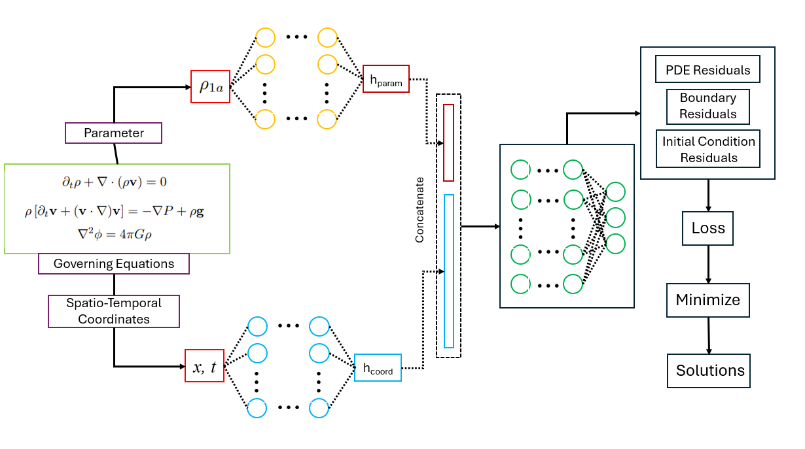
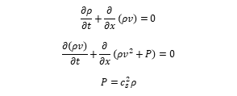
PINN Architecture
The implemented approach is inspired by the work on parameter-informed PINNs (P²INNs).
The core of our model is a modular design that separates the processing of physical parameters from the spatio-temporal coordinates. Our architecture is composed of three main components: a Parameter Embedding Network, a Coordinate Embedding Network, and a central Manifold Network.
Our model takes the initial perturbation strength as a learnable parameter. This parameter controls the non linearity of the solutions and possible shock development.
$$\frac{∂ρ}{∂t}+\frac{∂}{∂x}\left(ρv\right)=0$$
$$\frac{∂\left(ρv\right)}{∂t}+\frac{∂}{∂x}\left(ρv^{2}+P\right)=0$$
$$P=c_{s}^{2}ρ$$

Slide 8
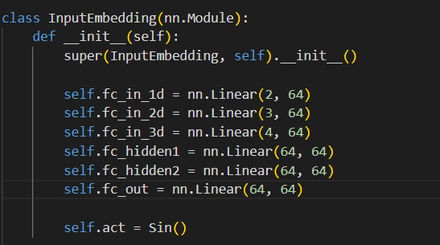
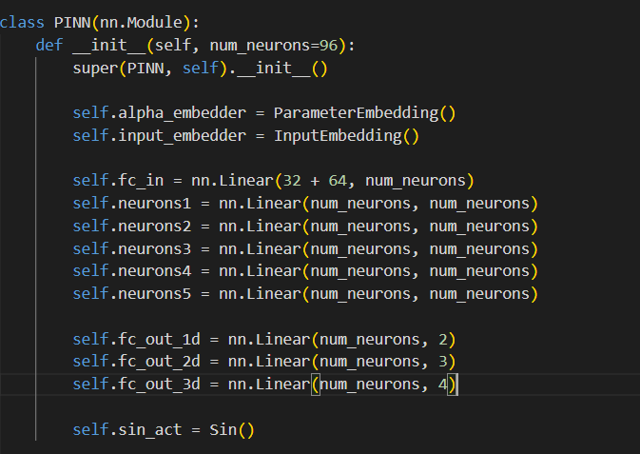
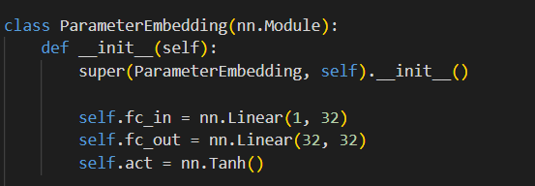
Model Implementation
The ParameterEmbedding network takes the learnable parameter (referred to as alpha in the code) and produces a hidden representation, which is fed into the main PINN.
The InputEmbedding network takes the spatio-temporal coordinates and produces a hidden representation, similar to the parameter network.
These representations are then concatenated and passed to the main PINN network, which learns the relation between the coordinates, the parameters and the solution.
Two major features of our system are extensive use of sinusoidal activation functions for better learning of complex high frequency solutions, and a residual connection in the main PINN network for training stability.

Slide 9
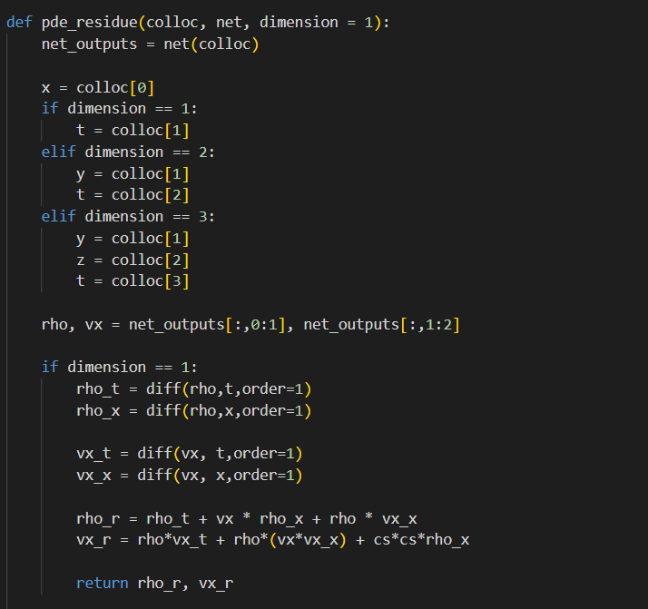
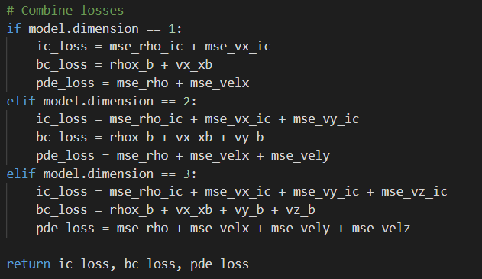
Modified loss function
The defining feature of PINNs is the addition of PDE residuals in the loss functions. This helps the model to converge to solutions satisfying the PDEs for the whole spatial and temporal domain.
For a unique solution to the PDEs of our system, Initial and Boundary Conditions (IC and BC) must be defined. We use a sinusoidal initial perturbation for the density and velocity, and periodic boundary conditions.
Weights are also assigned to IC, BC and PDE losses (optimal values found using trial and error) which lead to the PINN balancing each term appropriately and converge to better solutions.

Slide 10
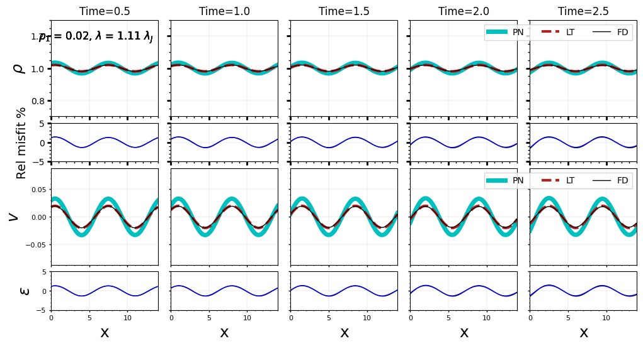
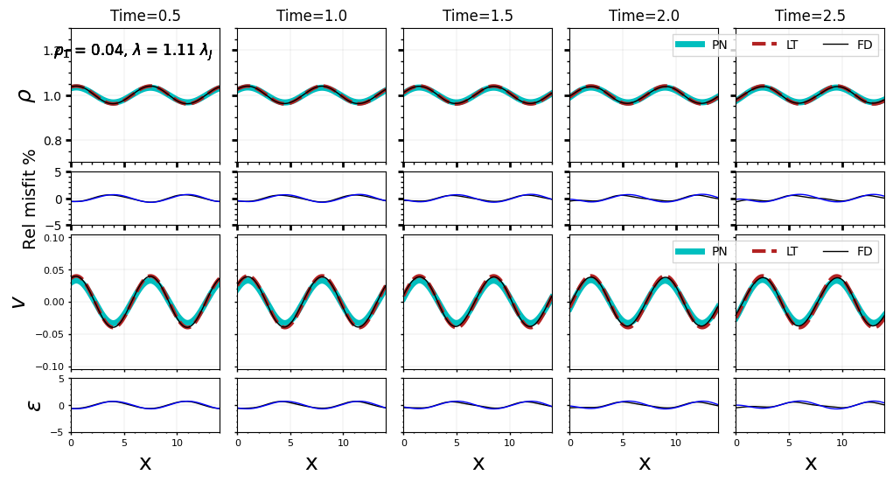
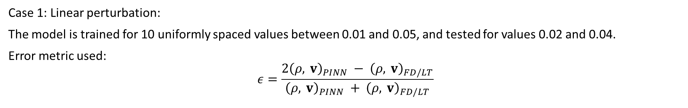
Results
Case 1: Linear perturbation:
The model is trained for 10 uniformly spaced values between 0.01 and 0.05, and tested for values 0.02 and 0.04.
Error metric used:
$$ε=\frac{2{\left(ρ, v\right)}_{PINN} − {\left(ρ, v\right)}_{FD/LT}}{{\left(ρ, v\right)}_{PINN} + {\left(ρ, v\right)}_{FD/LT}}$$

Slide 11
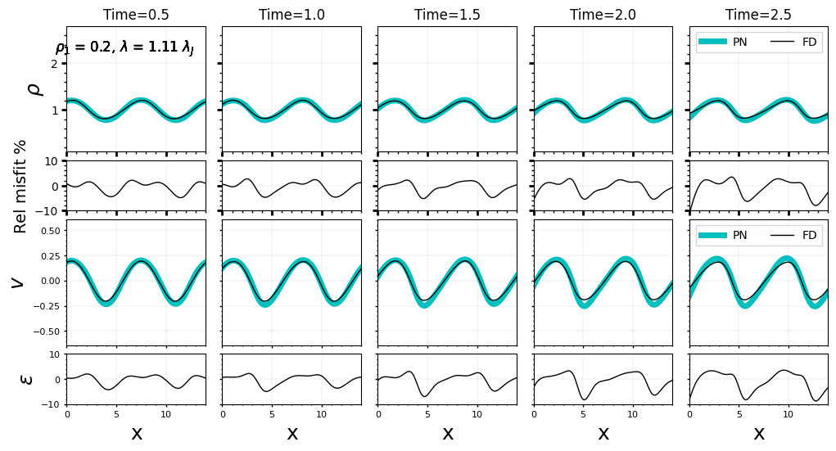
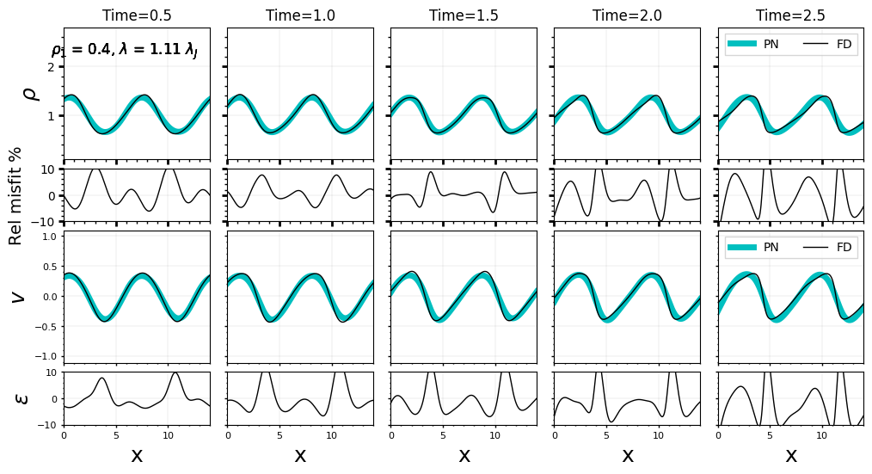
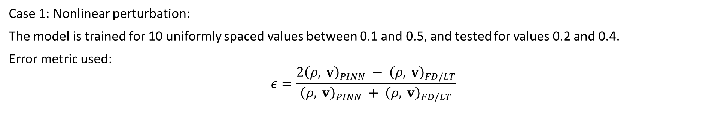
Results (continued)
Case 1: Nonlinear perturbation:
The model is trained for 10 uniformly spaced values between 0.1 and 0.5, and tested for values 0.2 and 0.4.
Error metric used:
$$ε=\frac{2{\left(ρ, v\right)}_{PINN} − {\left(ρ, v\right)}_{FD/LT}}{{\left(ρ, v\right)}_{PINN} + {\left(ρ, v\right)}_{FD/LT}}$$

Slide 12
Notes and Interpretation of results
For linear perturbations, the model has good results, with less than 5% error consistently.
For nonlinear perturbations, the error is close to 10% in some regions, but the model has learnt to handle the shocks developed in nonlinear regime, showing capability to model the complex phenomenon.
The model has slight extrapolation capabilities in the temporal domain; for both cases the model was trained up to t = 2.0, but the results till t = 2.5 show good match with true solutions.
For comparison, results from linear theory (for linear perturbations) and the LAX method of Finite Difference (for both linear and nonlinear perturbations) are used.
For both cases, the model was trained using a combination of 1001 Adam iterations and 201 LBFGS iterations. This combination of using Adam first and LBFGS later has shown to improve converge and performance of neural networks.
Also for both cases 2000 IC points, 2000 BC points and a 20000 points collocation domain was used, with training done in 2 batches of 10000 points each.

Slide 13
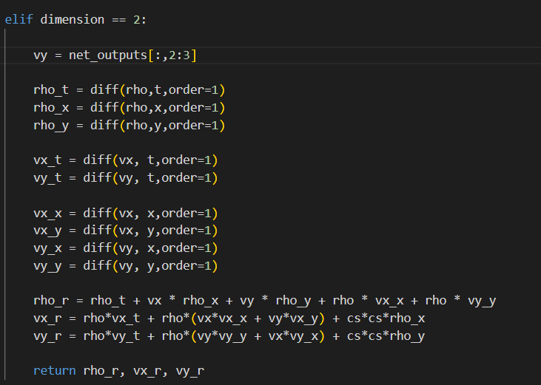
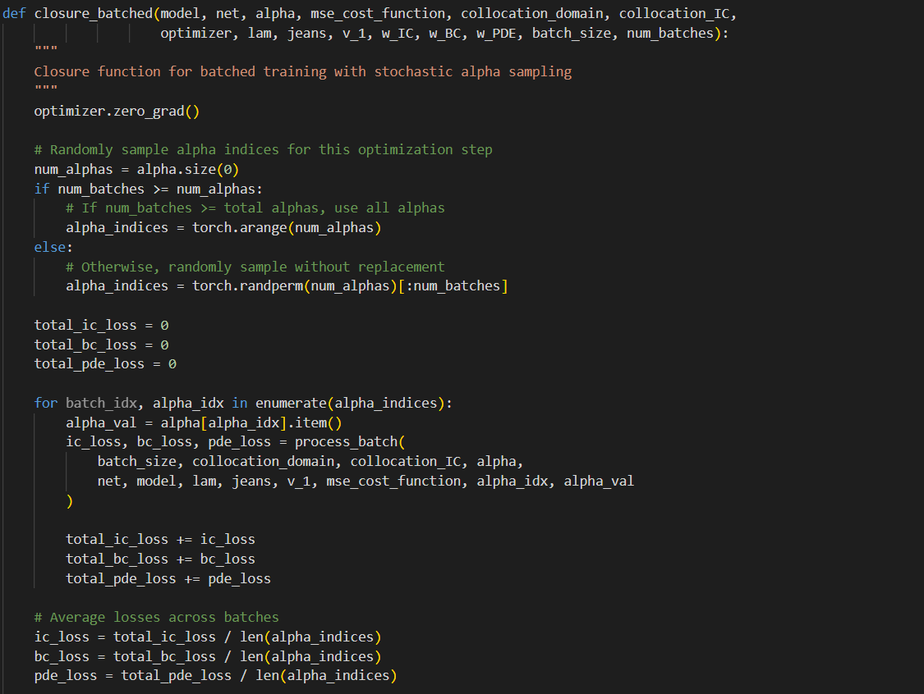
Additional features
Some additional features developed –
Batch processing, allowing training with limited computational resources.
Partial support for training 2D and 3D systems.
Partial support for including gravitational forces.
Modular code structure for easy usage and modifications.
The partial support for 2D and 3D systems and gravity can be used for future work on incorporating gravity. Hydrodynamical systems with gravity are important to study, for example to understand the evolution of molecular clouds.

Slide 14
THANK YOU
References:
https://arxiv.org/abs/2408.09446

